Slide 1
MTE307 FINAL PROJECT Sorting by color and filling with arm
Presented to
DR/Ahmed sabry
ENG/Khaled Abdel nasser

Slide 2
Presented to
DR/ Ahmed Sabry
ENG/ Khaled Abdel nasser

Slide 3
Presented by
Seif Eldeen Mohamed 200030848
Mohamed Medhat 200025912
Zain Mahmoud 200025947

Slide 4
Main objective
Designing PLC program to sort objects by their color
And Fill them using a robotic arm
This application can be used in many industries or Automation processes
Examples
Food Packaging Industries
Color paint sorting
Packaging Automation

Slide 5
Hardware System configuration
Robotic arms for picking objects
Photo sensors to detect the color
Moving belts to transfer the object
Boxes for packaging

Slide 6
Software system configuration
WHY WE USED LADDER DIAGRAM?
Easy to read and write
Easy to maintain
Easy to debug
Function blocks make complex topics simple
Compatible with most PLCs

Slide 7
Used functions
NO/NC contacts
Negative/positive pulse
Set/reset coil
Output coil

Slide 8
Addresses
I input
M marker
Q output

Slide 9
Process logic
The object arrives by the moving belt
The object reaches sensor position
The sensor detects the color of the object
Based on the color of object a belt moves
Once the object moves to arm position the arm picks it up
The arm puts the object in the box
The package continues moving

Slide 10
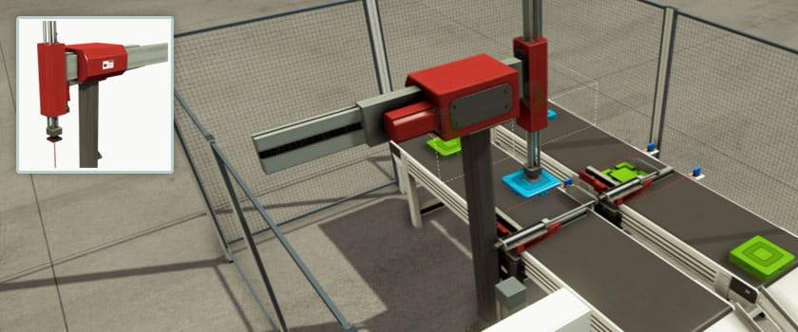
Hardware used
2 Robotic arms

Slide 11
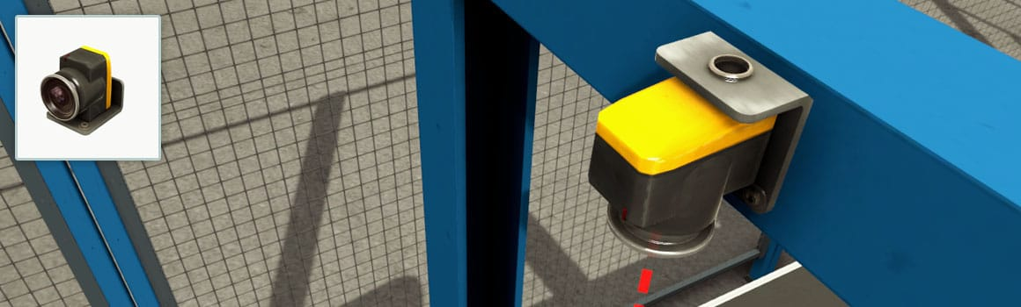
Hardware used
2 Photo sensors ( color detection )

Slide 12
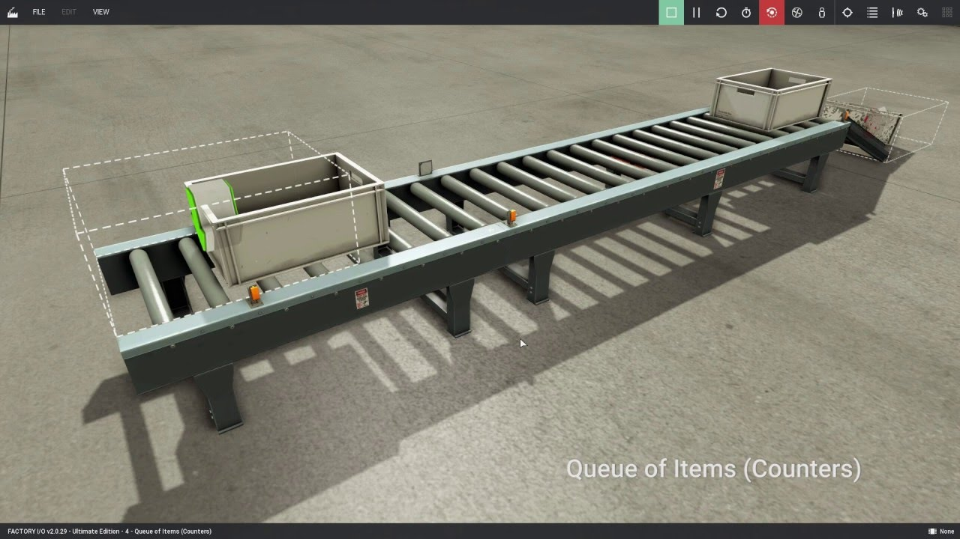
Hardware used
Boxes for packaging

Slide 13
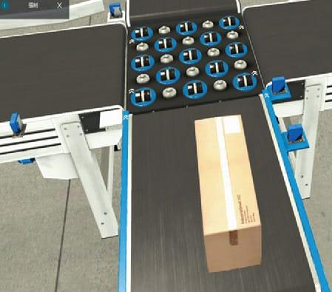
Belts for moving objects

